Slide 1



PREDICTING AN AIRLINE’S CUSTOMERS’ SATISFACTION USING SUPERVISED MACHINE LEARNING
FINAL PROJECT PROPOSAL
SHIFT ACADEMY DATA SCIENCE BOOTCAMP
BATCH 10 – GROUP 6
Ma’shum Abdul Jabbar
Lovidya Helmi
Damasus Made Singgih Aditama

Slide 2






CONTENTS
1. BACKGROUND
2. GOALS
3. DATA UNDERSTANDING
4. PROJECT FLOW
5. TIMELINE
6. TOOLS

Slide 3
BACKGROUND
OVERVIEW
As an industry that focuses on service, customer satisfaction is always on top of mind for airlines. Unhappy or disengaged customers naturally mean fewer passengers and less revenue. Therefore, it’s important that customers have an excellent experience every time they travel.
Higher satisfaction increases customer loyalty, resulting in customers who are willing to purchase more of – and spend more for – products and services. Knowing the relationship between customer satisfaction and yield is critical.
Notes:
.

Slide 4
BACKGROUND
SIMPLIFIED BUSINESS MODEL
Airline revenue mainly comes from passengers’ ticket fees
Cost of flying is influenced by many factors primarily fuel and labor fees
EXAMPLE: JKT-DPS, One-way flight, National Full-Service Carrier on 01AUG21 (Google Flight)
Business-class fare = 5.224.300 IDR; Economy-class fare = 1.321.600 IDR
Aircraft: Boeing 737 with a capacity of 12 on Business and 150 on Economy
Revenue at full load ≈ 260 million IDR*, while Total Cost per flight ≈ 165 million IDR*
Needs 90 to 126 passengers just to break even
In the same route, Low Cost Carriers put significantly lower fares.
If we are talking about fares alone, full service carriers would’ve gone bankrupt long ago
The cutting edge: passenger comfort and satisfaction (especially true for Full Service Carrier)
*Conservative estimates from different sources
Notes:
.

Slide 5
GOALS
BUSINESS GOAL
Discovering which aspects of the Airline’s provided service that need to be emphasized in order to gain the highest customer satisfaction.
With this information, the Airline can allocate their resources better in those aspects to maximize passengers’ satisfaction.
PREDICTION GOAL
Predicting whether future customers would be satisfied with the Airline’s service given the details of the other parameters values with Supervised Machine Learning (Classification)

Slide 6
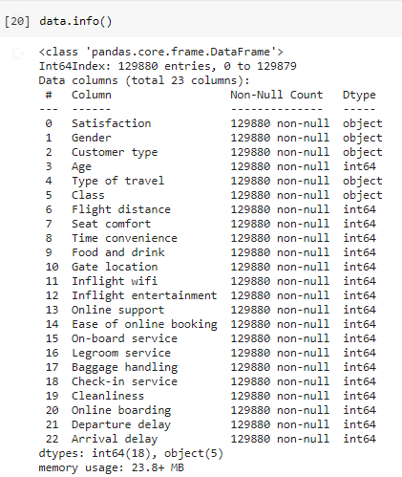
DATA UNDERSTANDING
ABOUT
Dataset source | https://www.kaggle.com/sjleshrac/airlines-customer-satisfaction
Airline | Anonymous (masked as Invistico Airline)
Data size | 189k entries Plan = 20% training and 80% test
No. of columns | 23 5 categorical 18 numerical

Slide 7
DATA UNDERSTANDING
DESCRIPTION (part 1)
Column Names | Type | Description
Satisfaction | Categorical | Satisfied or Dissatisfied (0 or 1)
Gender | Categorical | Male or Female (0 or 1)
Customer type | Numerical | Loyal or Disloyal (0 or 1)
Age | Numerical | Number showing the age of passengers at the time of survey
Type of travel | Categorical | Personal Travel or Business Travel (0 or 1)
Class | Categorical | Travel class of the passengers (Business, Economy, Economy plus)
Flight distance | Numerical | Number showing the distance of journey (km)
Departure delay | Numerical | Minutes delayed from the Estimated Time of Departure (ETD)
Arrival delay | Numerical | Minutes delayed from the Estimated Time of Arrivals (ETA)

Slide 8
DATA UNDERSTANDING
DESCRIPTION (part 2):
The following column names are pretty self-explanatory and refers to the level of satisfaction that were given numerical values of 0-5 by passengers where:
0 = either service unavailable or null; 1 = least satisfied; 5 = most satisfied
Column Names | Column Names
Seat comfort | Ease of online booking
Time convenience | On-board service
Food and drink | Leg room service
Gate location | Baggage handling
Inflight wifi | Check-in service
Inflight entertainment | Cleanliness
Online support | Online boarding

Slide 9
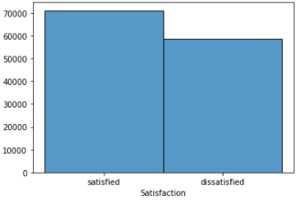
DATA UNDERSTANDING
From all responses towards satisfaction: ~71K passengers are satisfied (54.7%), while ~58K passengers are dissatisfied (45.3%)

Slide 10
PROJECT FLOW
SUBMISSION OF PROPOSAL | DATA CLEANING | EXPLORATORY DATA ANALYSIS | MODELING | EVALUATION | FINAL PRESENTATION
Selecting dataset Determining the outline of project Finalizing the proposal | Data pre- processing Encoding Treatment of null values | Visualization to get the insights of data Use USML for EDA (PCA?) | Testing various classification algorithms with training data (KNN? XGboost? Random forest? *TBD) | Evaluating performance metrics (recall, precision, f1 score, ROC/AUC) using test data | Finalizing presentation slides Know how to present effectively Anticipating any sort of questions

Slide 11
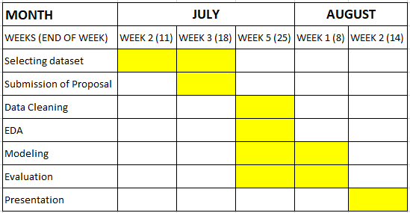
TIMELINE

Slide 12







TOOLS
Github
Pandas
Google Colab
Matplotlib
Seaborn
Scikit-learn
Numpy

Slide 13
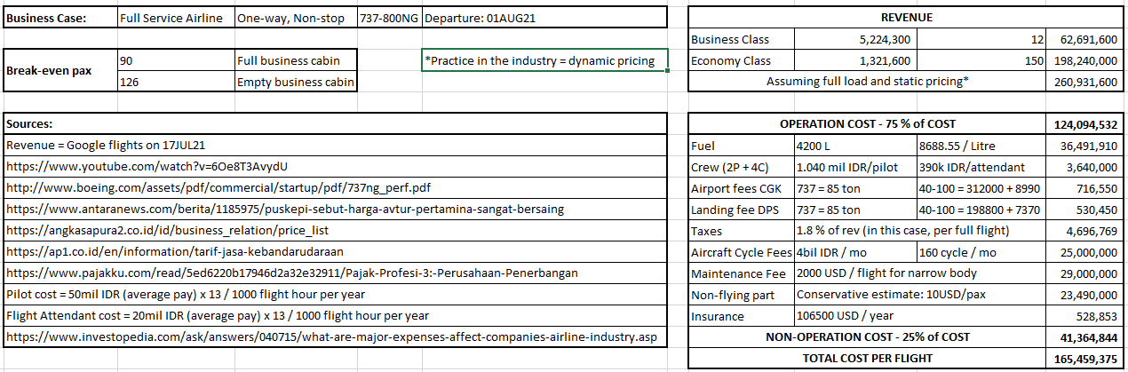
APPENDIX

